Slide 1
Strategies for Expanding into International Markets
Wilson

Slide 2
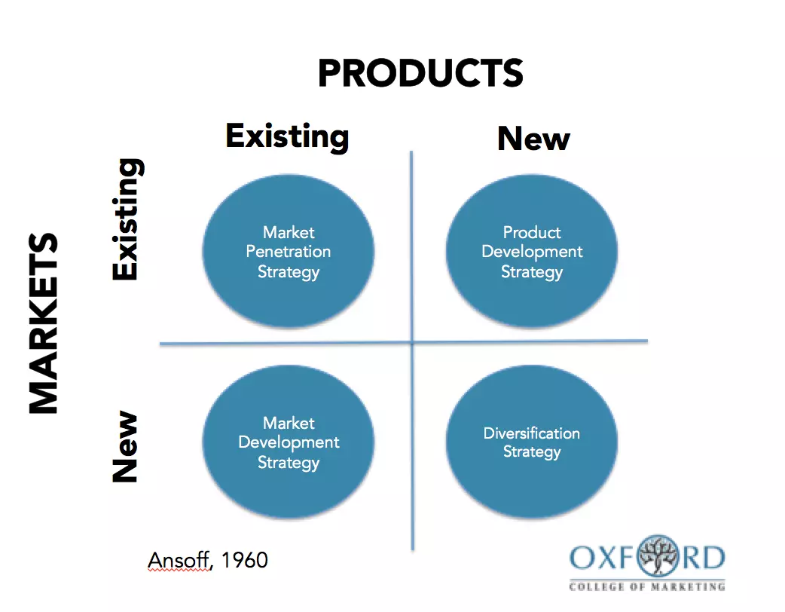
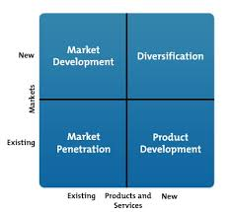
ANSOFF MATRIX

Slide 3
The main methods of investing in international markets
1. Exporting direct to international customers
Advantages
Uses existing systems – e.g. e-commerce
Online promotion makes this cost-effective
Can choose which orders to accept
Direct customer relationship established
Entire profit margin remains with the business
Can choose basis of payment – e.g. terms, currency, delivery options etc
Disadvantages
Potentially bureaucratic
No direct physical contact with customer
Risk of non-payment
Customer service processes may need to be extended (e.g. after-sales care in foreign languages)

Slide 4
main methods of investing in international markets
2. Selling via overseas agents or distributors
Advantages
Agent of distributor should have specialist market knowledge and existing customers
Fewer transactions to handle
Can be cost effective – commission or distributor margin is a variable cost, not fixed
Disadvantages
Loss of profit margin
Unlikely to be an exclusive arrangement – question mark over agent and distributor commitment & effort
Harder to manage quality of customer service
Agent / distributor keeps the customer relationship

Slide 5
main methods of investing in international markets
3. Opening an operation overseas
Advantages
Local contact with customers & suppliers
Quickly gain detailed insights into market needs
Direct control over quality and customer service
Avoids tariff barriers
Disadvantages
Significant cost & investment of management time
Need to understand and comply with local legal and tax issues
Higher risk

Slide 6
main methods of investing in international markets
4. Joint venture or buying a business overseas
Advantages
Popular way of entering emerging markets
Reduced risk – shared with joint venture partner
Buying into existing expertise and market presence
Disadvantages
Joint ventures often go wrong – difficult to exit too
Risk of buying the wrong business or paying too much for the business
Competitor response may be strong

Slide 7
FACTORS TO CONSIDER WHEN EXPANDING INTO INTERNATIONAL MARKETS
Cultural differences: a business needs to understand local cultural influences in order to sell its products effectively.
Language issues: although the common business language worldwide is now English, there could still be language issues. Can the business market its product effectively in the local language? Will it have access to professional translators and marketing agencies?
Legislation: legislation varies widely in overseas markets and will affect how to sell into them. A business must make sure it adheres to local laws. It will also need to consider how to find and select partners in overseas countries, as well as how to investigate the freight and communications options available.

Slide 8
Ethics and Social Responsibility For an Entrepreneur
Social Responsibility means eliminating corrupt, irresponsible or unethical behaviour which might harm to the community, its people and the environment.
1) Public Image. The activities of an entrepreneur towards the welfare of the society earn goodwill and reputation for the business. People prefer to buy products of a company that engages itself in various social welfare programs. Again good public image also attracts the honest and competent employees to work with such employers.
2) Employee Satisfaction. Employees are the part of the society. If you satisfy your needs, then you are doing social work.

Slide 9
Ethics and Social Responsibility for an Entrepreneur cont…
3) Ethical Leadership. It is the belief that what entrepreneur does has a strong influence on employees. If manager cheats, Lies, steals or manipulates, then they are sending wrong signals to employees.
4) A social Entrepreneur is an individual or organization who seeks out opportunities to improve society by using practical, innovative and substantial approaches.
5) Environment Management. Managers and Organizations can do many things to protect and preserve the natural environment which includes plastic less business by giving paper bag, creating eco-friendly product, by eliminating production.
6) Consumer Awareness. Consumers have become very conscious about their rights. If you are giving high quality products at cheap rate, that is kind of social Responsibility

